Slide 1
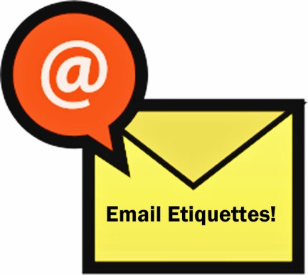
Email Etiquette
This is a discussion on email etiquette, with a focus on forwarding etiquette

Slide 2
What is etiquette?
The rules which indicate the “correct” way to behave in a certain time and place.
Email etiquette is especially important in the work place
Notes:
Example: When in the work place, there are appropriate and inappropriate ways to use email.

Slide 3
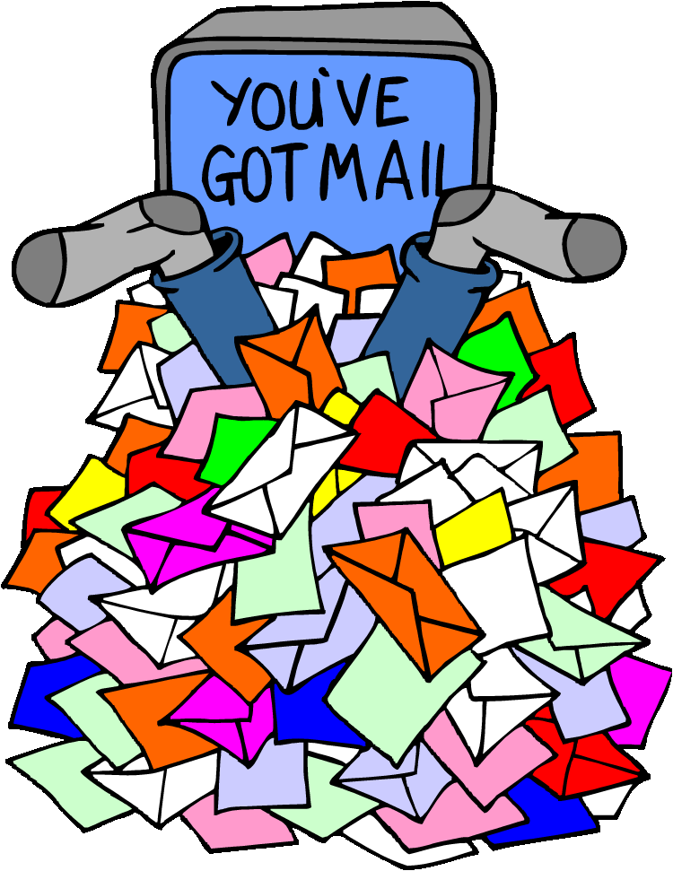
5 Basic Email Etiquette Rules

Slide 4
Rule #1: Always include a subject and use the recipient’s name in the greeting
Why is a subject important?
It informs recipient what the email is about.

Slide 5
Rule #2: Do not write in ALL CAPITALS
Writing in all capitals can convey that you are shouting in your message, and nobody likes to be yelled at. Consider other ways to get your message across while conveying its importance. Using all capitals can be annoying and trigger an unintended response.

Slide 6

Rule #3: Do not use email to discuss confidential information

Slide 7
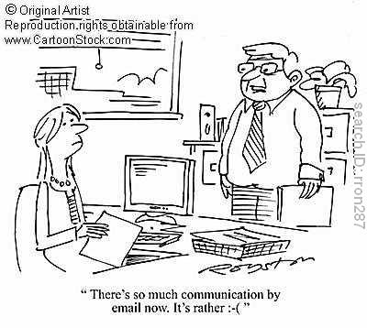
Rule #4: Take care with abbreviations and emoticons ☺
Save abbreviations like LOL (laugh out loud) or IDK (I don’t know) for text messages among friends.
Some may not understand your abbreviations
Not professional

Slide 8
Rule #5: THINK before you send
If you answer yes to all of these questions:
Is this relevant to the work my organization is doing?
Will the office benefit professionally from this information?
Okay to send!

Slide 9
But if you answer NO to any of these…
Could this information hurt/embarrass/offend someone?
Email should not be used for confrontation/yelling/reprimanding
Could this email be misinterpreted in a bad way?
Is this information important to share in the workplace?
Could this email get me into trouble?
Part of Rule #5: Do NOT send!

Slide 10
What is the purpose of email in the workplace?
Quick communication
Share PROFESSIONAL information
Keep records of communication
It is NOT for:
sharing funny email forwards that your friends send you
sharing political or religious views
harassing coworkers
inappropriate conversations

Slide 11
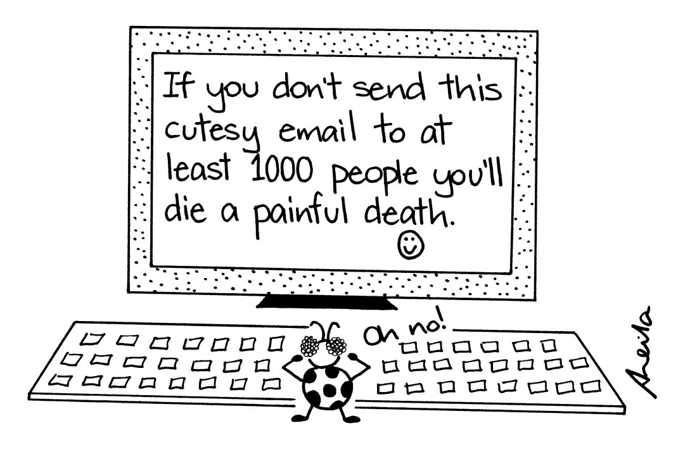
Rule #6: Do not Forward unnecessary/unrelated Emails

Slide 12
Rules for Forwarding
If you cannot take the time to write a personal comment at the top of your forwarded email to the person you are sending to – then you shouldn’t forward it at all.
Think carefully about if what you are forwarding will be of value, appreciated or humorous to the person on the other side.
If an email tells you to “Forward to everyone you know/love/all of your family” do NOT forward
Notes:
Value-accurate information
Appreciated- something the recipient needs
humorous (do they have the same sense of humor as you do)
If you cannot think of why the person you are forwarding to would like to receive the email – then don’t forward it.

Slide 13
Forwarding
Is it a good idea to forward emails that promise money or goods?
Should you forward emails to as many contacts as possible?

Slide 14
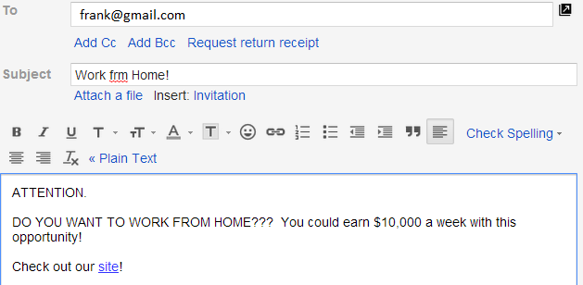
Example 1: Would this email be relevant to someone?

Slide 15
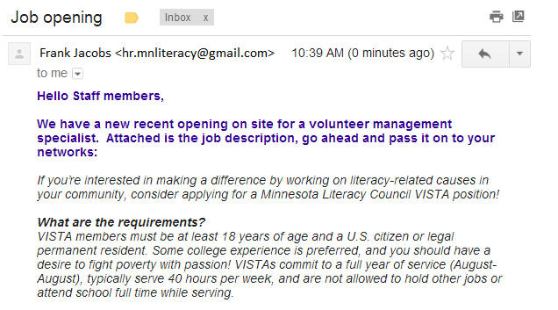
Example 2: Would this email be relevant to someone?

Slide 16
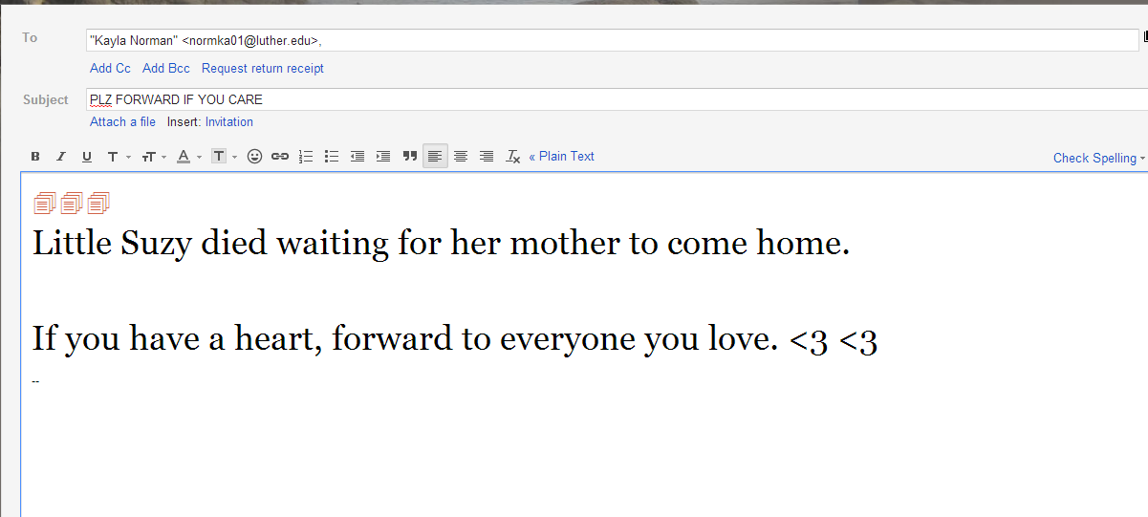
Example 3: Would this email be relevant to someone?

Slide 17
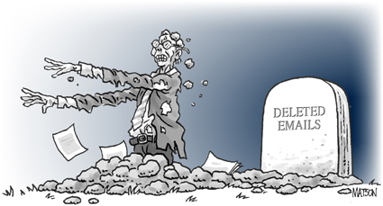
REMEMBER: When you send an email to someone, they are getting a copy that they can keep…forever.

